Slide 1

AUTOMATION TESTING
PRESENTED BY K.INDRA KUMAR

Slide 2

AUTOMATION:
Automation is a term for technology applications where human input is minimized. This includes business process automation (BPA), IT automation, personal applications such as home automation and more.
TYPES OF AUTOMATION:
Basic automation
Process automation
Integration automation
Aritificial intelligence automation

Slide 3
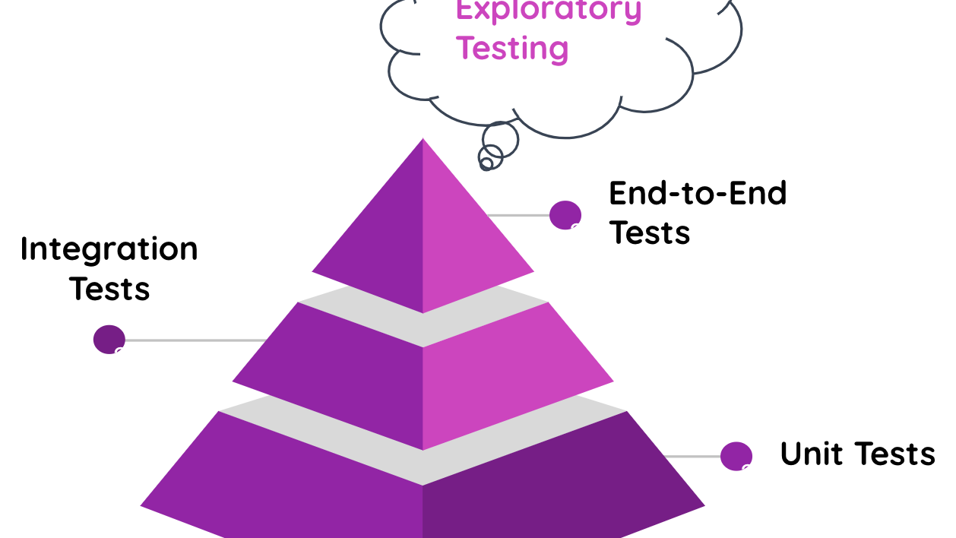
TEST AUTOMATION:
Test automation is the practice of automatically reviewing and validating a software product, such as a web application, to make sure it meets predefined quality standards for code style, functionality (business logic), and user experience.
Testing practices typically involve the following stages:
Unit testing: validates individual units of code, such as a function, so it works as expected
Integration testing: ensures several pieces of code can work together without unintended consequences
End-to-end testing: validates that the application meets the user’s expectations
Exploratory testing: takes an unstructured approach to reviewing numerous areas of an application from the user perspective, to uncover functional or visual issues

Slide 4
IMPORTANCE OF AUTOMATION:
Automation testing saves time, money, and effort. The software development process includes a few successive development cycles that simply can't be done without repetitive executions of the same tests. And this is where test automation for startups can tackle that challenge and speed up the process.
Software testing, an integral part of the development process for software applications that meet the highest standards of quality, can be a complex process, to say the least. With the increasing number of functionalities that applications today are bestowed with, not to mention the large number of platforms and browsers to account for, there is an ever increasing possibility of bugs and issues going unnoticed. However, the highly competitive market scenario does not allow software developers the luxury of allowing products with even minor bugs to reach the market, as a product with issues will be outright rejected.

Slide 5
REASONS FOR AUTOMATION:
To increase labor productivity. ...
To reduce labor cost. ...
To mitigate the effects of labor shortages. ...
To reduce or eliminate routine manual and clerical tasks. ...
To improve worker safety. ...
To improve product quality. ...
To reduce manufacturing lead time. ...
To accomplish processes that cannot be done manually.
TO avoid the high cost of not automating

Slide 6
TEST CASES USED IN AUTOMATION
Unit Testing:
Unit testing is the fastest method of testing and, therefore, should be the highest priority for your automation. ...
Integration Testing:
Integration testing, where we're testing our interfaces or modules, should also take high priority. ...
Functional Testing:
It is a type of testing that seeks to establish whether each application feature works as per the software requirements.

Slide 7
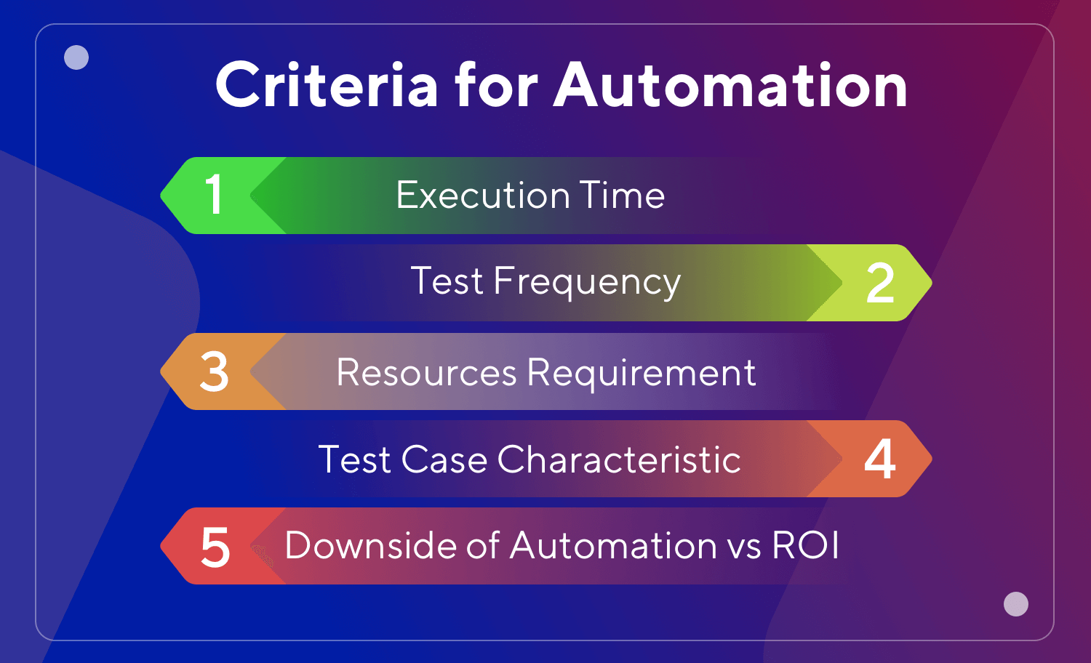

Slide 8
STEPS FOR AUTOMATION PROCESS
STEP1 : Test tool selection
STEP2 : Define scope for automation
STEP3: Planning , design and develop
STEP4: Test execution
STEP5: Test automation maintenance approach

Slide 9
FRAMEWORK FOR AUTOMATION
Test automation framework is a comprises tools, guidelines, resources, and rules required to bring automation to the testing process. They will be located in a single place so that you do not have to spend time looking for them.
For instance, imagine that you are at an airplane ticket counter. The ticket counter also serves as a place to get answers to your queries, get the boarding pass, etc. A lot of services at one place! Sounds good right?
Likewise, the test automation framework provides all the necessary information and resources you need to execute the test cases in one place.
Test automation framework can prepare test cases based on the latest circumstances by providing syntaxes, methodology, preparing testing iteration, etc. so that testing can commence easily.

Slide 10




THANK YOU…

